Slide 1

HEALING HELPERS MEDICAL GROUP
Group Name: Neo Smart
Group Members: Apoorva. M
Arpana. G

Slide 2
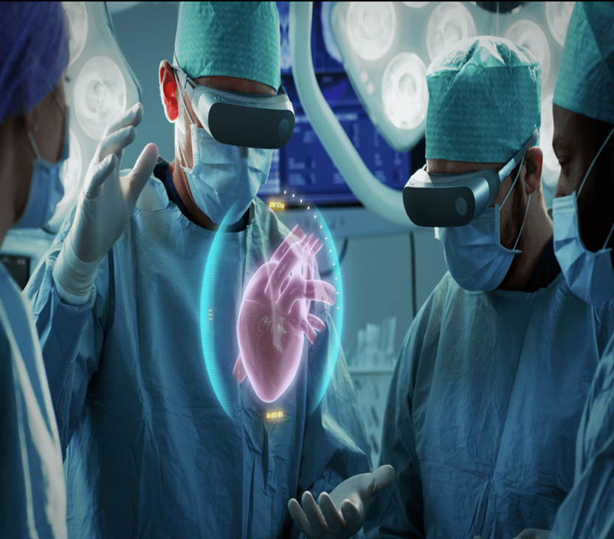
How does XR technology work?
XR uses advanced computer technology, graphics, and input systems that allow learners to co-exist and interact with physical and digital objects in real-time. With mixed reality, learners can direct their vision in 360° across an entire space and in every direction.

Slide 3
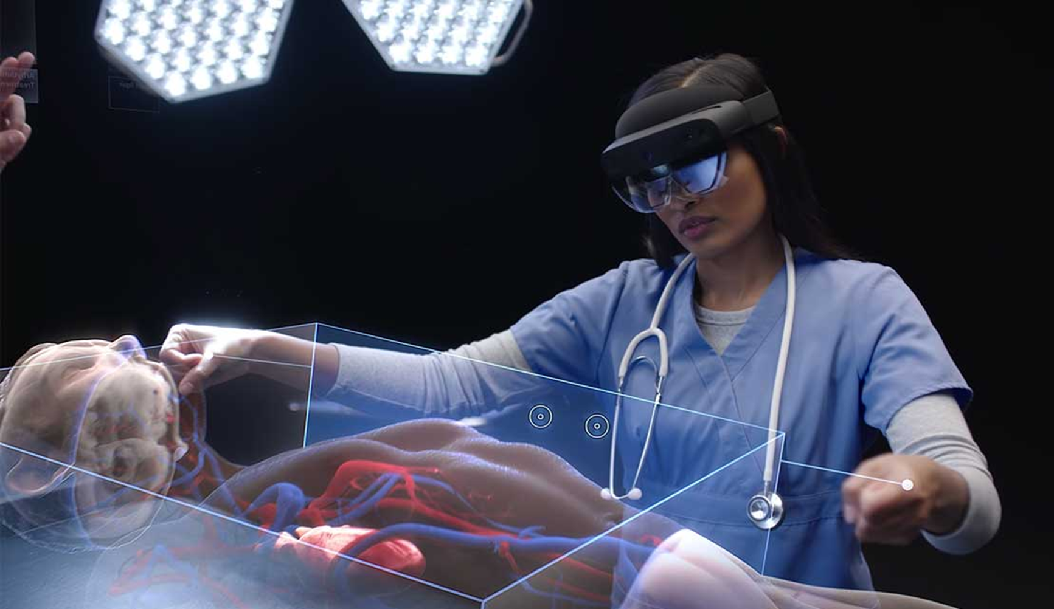
What is the potential benefits of applying Extended Reality solutions to surgical science?
The ability to overlay 3D models generated from CT scans and MRIs on the surgical field during the procedure maximizes the surgical team's ability to choose the best points of entry and procedural techniques to reduce recovery time and improve outcomes for the patient.

Slide 4
USE CASE ON MANIPAL UNIVERSITY
Due to the pandemic and its subsequent effect on school and college shutdown the education has faced a setback. This has especially affected the medical profession, as it requires campus experience. With an aim to give students a campus learning experience, while managing their time and stress, the MedAce, a smartly designed recourse pool aims to give them interactive learning from their comfort," said Balasundaram Athreya, Chief Digital Officer, Manipal Global Education Services & Business Head, Manipal MedAce
MedAce, allow first-year MBBS students to have early clinical exposure and apply Basic Sciences principles in a hospital setting. Assessments include case-based and image-based questions to perform well in-class tests and university exams. Overall outcomes for the student include achieving competencies and skillsets required for an Indian Medical Graduate, Rao added
Talking about the pricing of the MedAce- Manipal Global Education Services, “It is a cloud-based resource. This is a very affordable assessment resource that can be acceded by anyone from any part of the country. Manipal MedAce is the outcome of extensive market research done by us on the need gap present in undergraduate MBBS learning today."

Slide 5
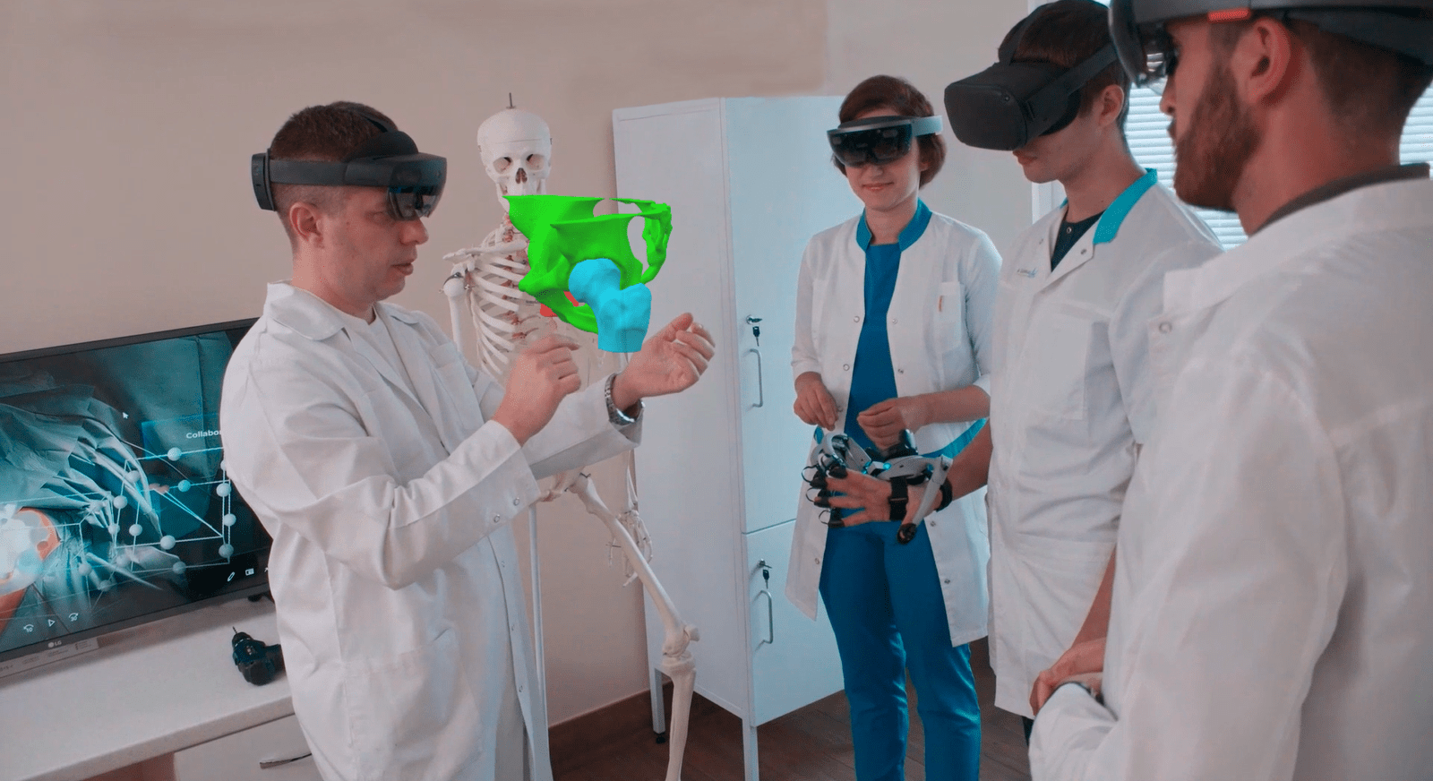
Building a Solution Around Augmented Practice
AR can bring to the field of medicine and education are revolutionary. Medical institutions are beginning to implement AR into their curriculum to provide students with a valuable hands-on learning experiences. Essentially, the idea for using AR in education is to simulate patient and surgical encounters for students to make all of their mistakes on AR rather than in a dissection lab or worse, in a real-life procedure. Students will use AR so they can accurately learn about diagnosing patients with health conditions or take part in an AR surgical procedure. AR technologies will also allow medical professionals to continuously observe and give feedback to students during their practice.
Another advantage of implementing AR into education is that training can now be made more systematic. Through an AR training program, doctors in training can practice on anything and everything that may come up in a real-life medical situation rather than randomly training with what’s given in a dissection lab. Medical students have always based medicine on theory and proven evidence, and now AR technologies actually allow them to visualize and practice those theories during their training. An example of this are AR apps that can be used to overlay anatomy data on a 3D human skeleton, giving them a better understanding of how the human body works.

Slide 6
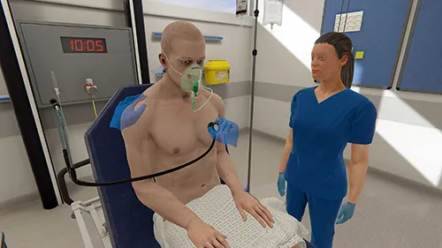
What Benefits Does XR Offer Over Physical Training?(Business Value proposition)
XR revolutionizes the traditional approach to healthcare training. This is particularly true with virtual reality.
XR simulation authentically replicates manikin-based simulation scenarios so that trainees and practitioners alike can practice safely, developing their skills and confidence in a lifelike environment, with no compromise to learner outcomes.
The most exciting part about XR technologies in healthcare training is, they require a smaller number of resources, reach more users, and can provide feedback on improvement over time — helping you prove that you’re getting a return on your investment.

Slide 7

Augmented Surgery
As data access technologies are already very advanced, the next step is to provide real-time, life-saving patient information to surgeons which they can use during simple or complex procedures. Augmented reality will allow surgeons to precisely study their patients’ anatomy by entering their MRI data and CT scans into an AR headset and overlay specific patient anatomy on top of their body before actually going into surgery. Surgeons will be able to visualize bones, muscles, and internal organs without even having to cut open a body. This could also help them determine exactly where to make injections and it could be used to display life-saving information for paramedics and first responders during a medical emergency. AR can not only be used to perform accurate and low-risk surgeries, but it can also help surgeons save time in the case of an emergency surgery. Instead of searching among papers or through electronic medical records, surgeons can have access to all of that information on their AR screen within seconds.

Slide 8
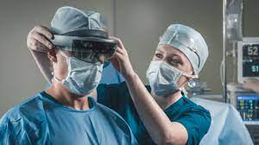
Healthcare metaverse
The Metaverse in Medicine can be defined as the medical Internet of Things facilitated using AR and VR glasses.
How the Metaverse can change healthcare?
The Metaverse will allow simultaneous education, training, and planning as well as collaborative medical procedures. Combined with AI, this can empower clinical decision- making and ensure more precise interventions which are tailored to each individual patient.

Slide 9
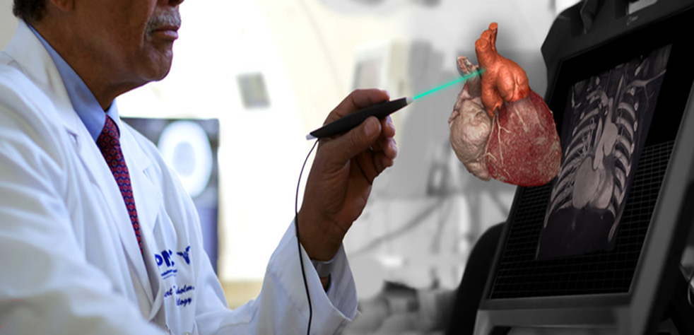
Marketing
To medical practitioners
To Medical and Paramedical students
To any one willing to learn the XR for medical applications.
HOW?
Through social media
Through E- commerce website
Through Bulk sms
Through Free online webinars for students

Slide 10

Measuring Success through
Revenue
Comparison
Cost of learning

Slide 11
THANK YOU

